Slide 1
Sequence Clustering
Zhenmiao Zhang

Slide 2
1. Metagenomic (Compositional) binning
Object: short sequence [A|T|C|G]^{100~400} of a microbial community
Data size: millions to billions of sequences
Algorithm:
Reference sequence based: Kraken, Kraken2, CLARK (Efficient, accurate, but limited to known species)
Pair-wise alignment and hierarchical clustering: OGRE (Large memory, takes weeks or months)
Probabilistic model and kmeans: MetaProb (not scalable)
Locality-sensitive hashing: Opal

Slide 3
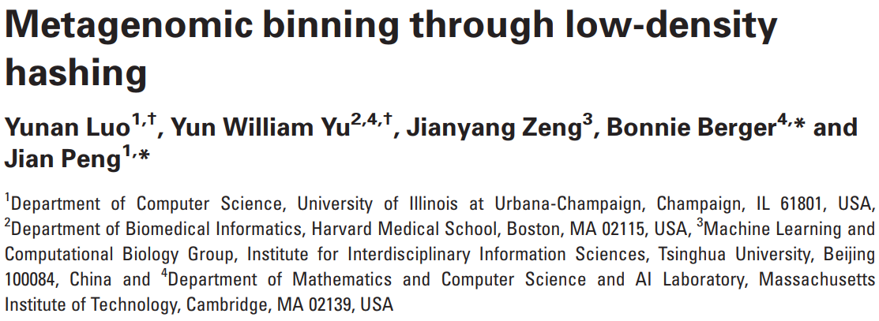

Slide 4

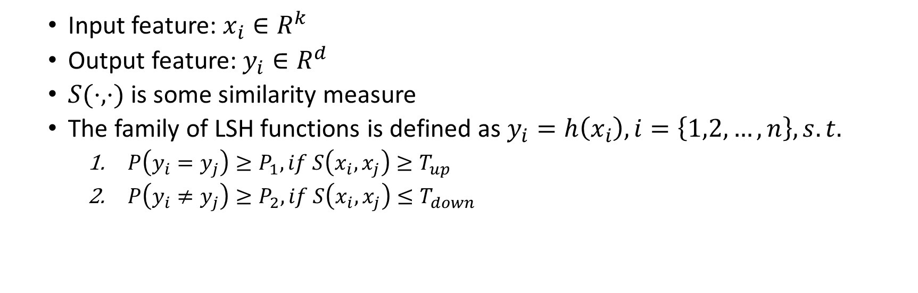
Locality-sensitive hashing (LSH)
Input feature: $x_{i}∈R^{k}$
Output feature: $y_{i}∈R^{d}$
$S(⋅,⋅)$ is some similarity measure
The family of LSH functions is defined as $y_{i}=h\left(x_{i}\right), i=\left\{1,2,…,n\right\},s.t.$
$P\left(y_{i}=y_{j}\right)≥P_{1},if S\left(x_{i},x_{j}\right)≥T_{up}$
$P\left(y_{i}≠y_{j}\right)≥P_{2},if S\left(x_{i},x_{j}\right)≤T_{down}$

Slide 5
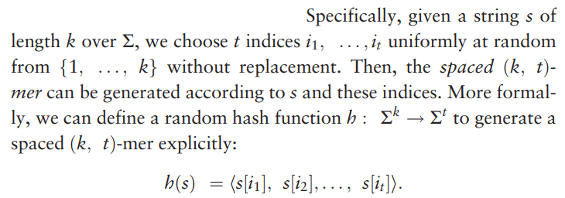
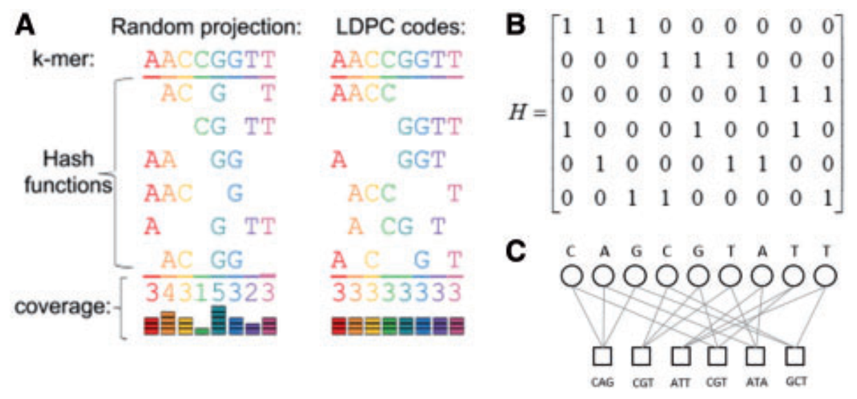




Sequence Encoding (LSH)
If $s_{1}$ and $s_{2}$ have r different nucleotides by most,
The random hash function cannot guarantee even coverage!
If $s_{1}$ and $s_{2}$ have R different nucleotides by least,

Slide 6
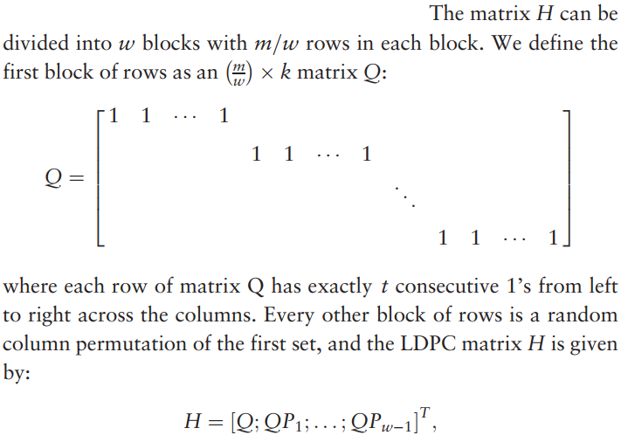
Sequence Encoding (Gallager codes)
t=4, m=6, w=2
t=3, m=6, w=3

Slide 7
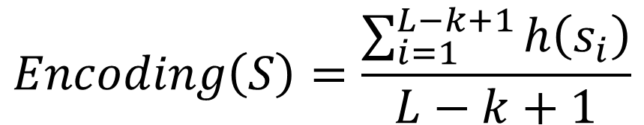
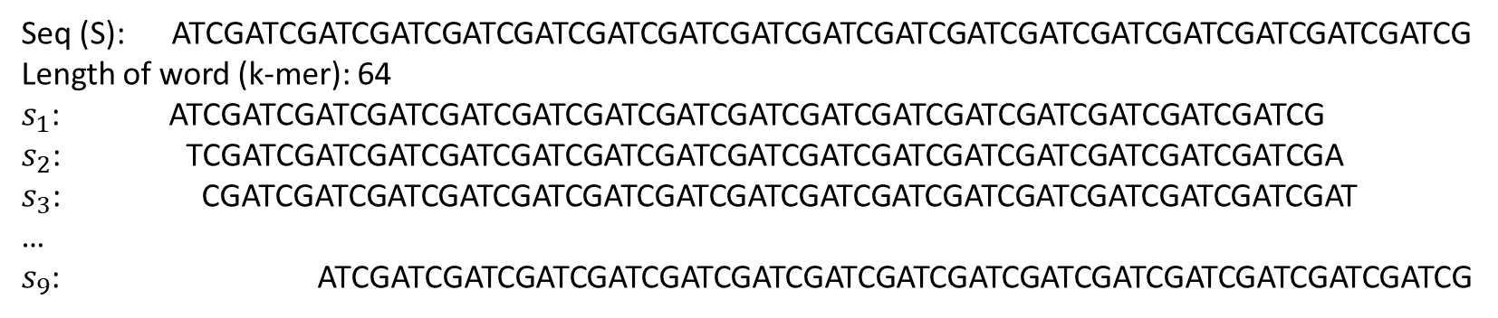
Sequence Encoding (length L)
Seq (S): ATCGATCGATCGATCGATCGATCGATCGATCGATCGATCGATCGATCGATCGATCGATCGATCGATCGATCG
Length of word (k-mer): 64
$s_{1}$: ATCGATCGATCGATCGATCGATCGATCGATCGATCGATCGATCGATCGATCGATCGATCGATCG
$s_{2}$: TCGATCGATCGATCGATCGATCGATCGATCGATCGATCGATCGATCGATCGATCGATCGATCGA
$s_{3}$: CGATCGATCGATCGATCGATCGATCGATCGATCGATCGATCGATCGATCGATCGATCGATCGAT
…
$s_{9}$: ATCGATCGATCGATCGATCGATCGATCGATCGATCGATCGATCGATCGATCGATCGATCGATCG
$$Encoding\left(S\right)=\frac{\sum_{i=1}^{L−k+1}{h\left(s_{i}\right)}}{L−k+1}$$

Slide 8
Advantages of LSH
It allows capturing long-range correlations (k=64 or 128) while keeping the feature space small (by LSH).
The other is that it admits a greater number of substitution differences than contiguous k-mers while still mapping to similar values.

Slide 9
Model Training
k = 64; t = 16 and 8 hash functions (default)
Opal samples 200-nucleotide fragments from the reference with coverage 15X
One-against-all SVM

Slide 10
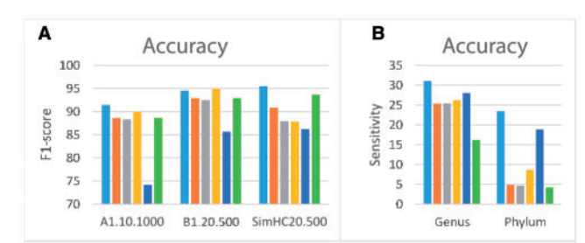
Results
A: Opal is compared against Kraken, CLARK, CLARK-S, Kaiju, and Metakallisto on the public benchmark datasets SimHC20.500, A1.10.1000, and B1.20.500 of 20, 10, and 20 species, respectively.
B: Opal has greater sensitivity to novel lineages in benchmarks on a large 193-species dataset.

Slide 11
2. Metagenomic contig binning
Object: long sequence [A|T|C|G]^{500~millions} of a microbial community
Data size: sum up to millions of base pairs
Algorithm:
Sequence composition based: MaxBin2, MetaBAT2, CONCOCT, MyCC, VAMB
Assembly graph based: GraphBin, METAMVGL, MetaCoAG

Slide 12
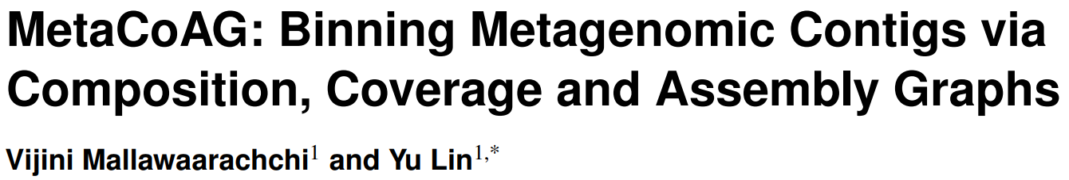

Slide 13
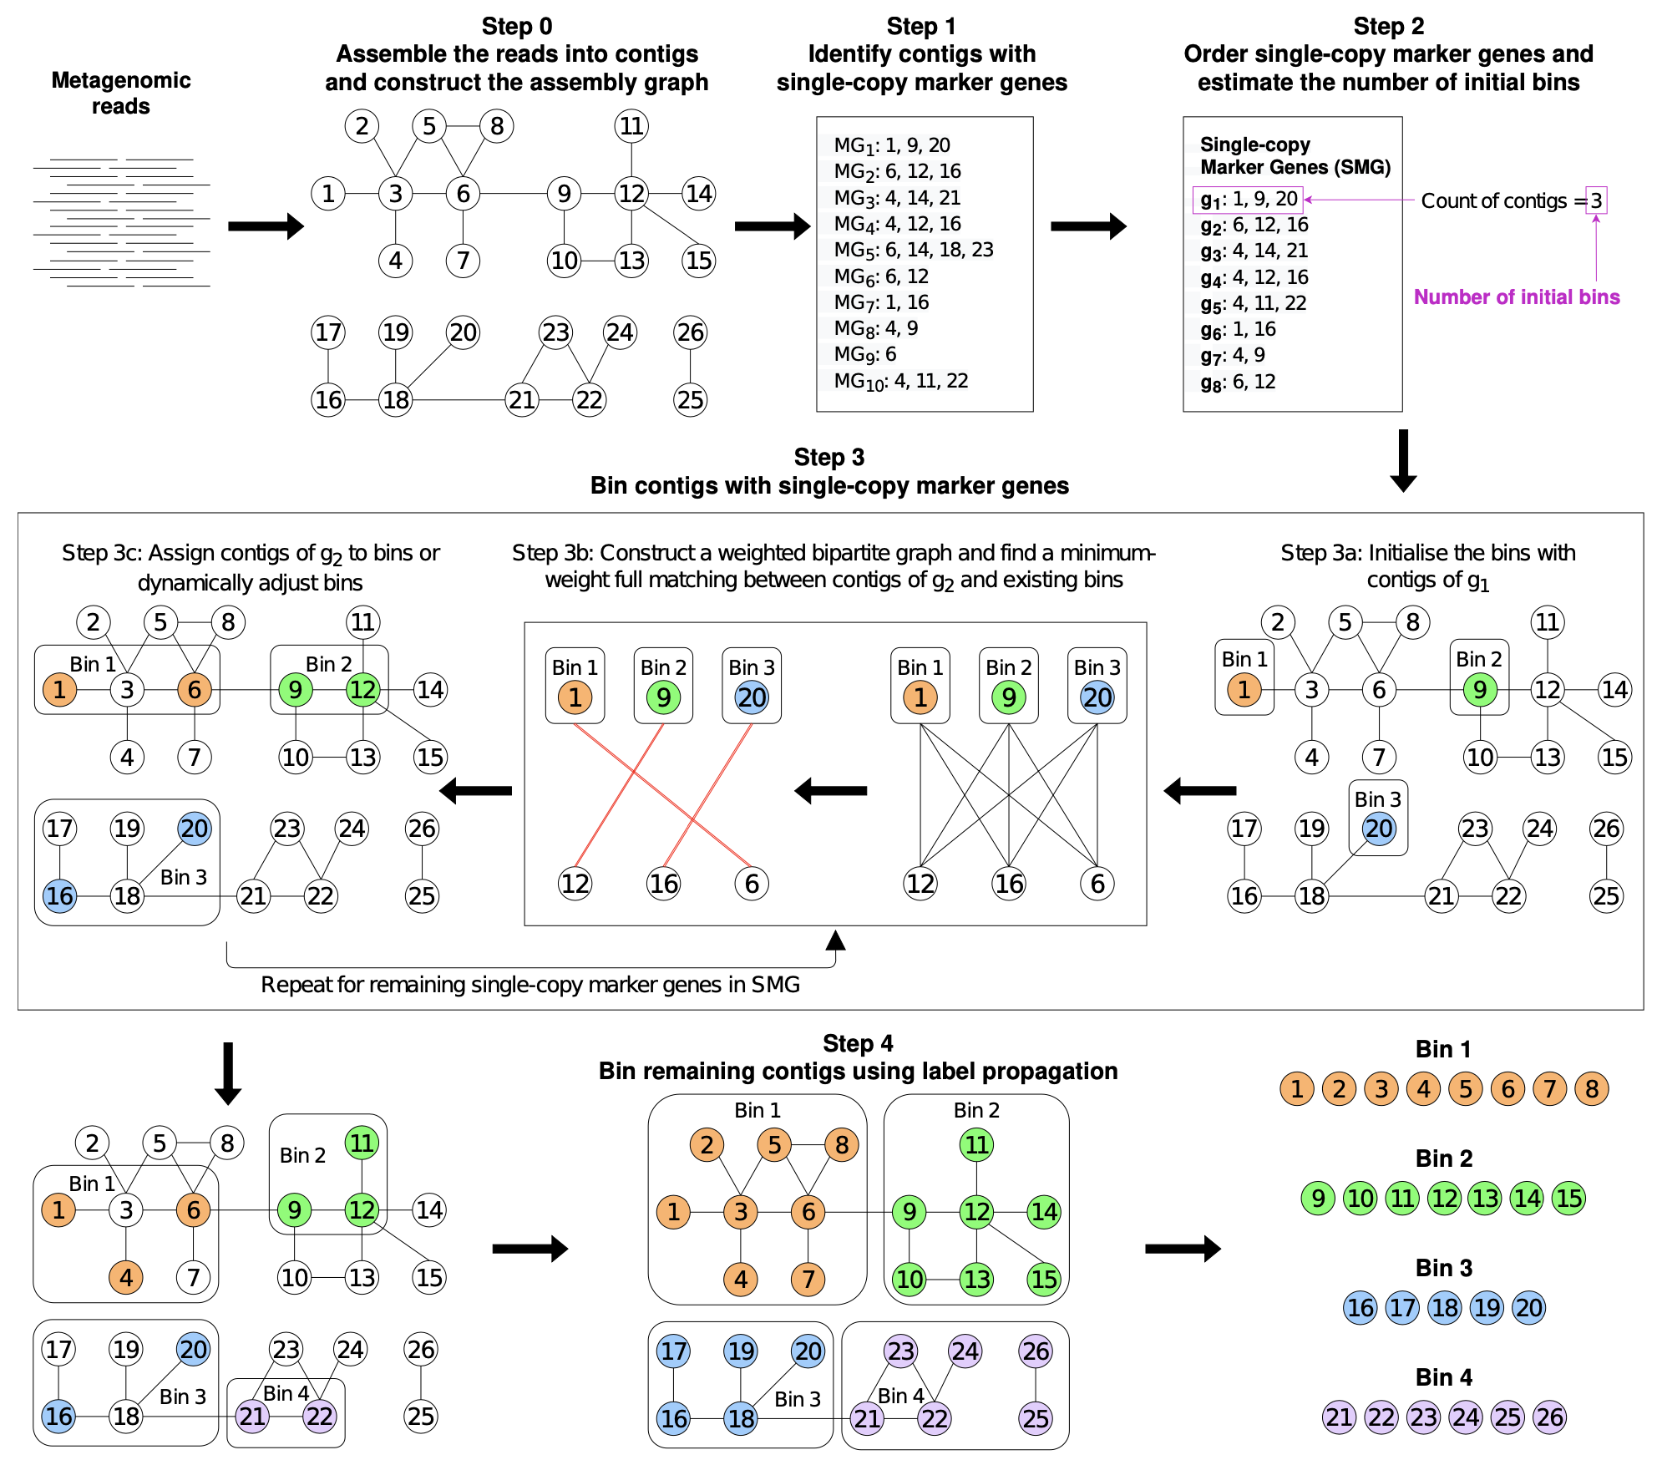
Overview

Slide 14
Initial Cluster Numbers
Step 2:
MetaCoAG orders all the single-copy marker genes according to the descending order of the number of contigs containing them.
Then, the number of initial bins is set to be the largest count of contigs a marker gene has to recover the maximum number of species possible from the marker gene information.

Slide 15
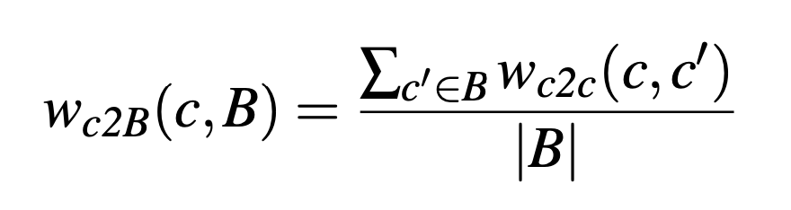
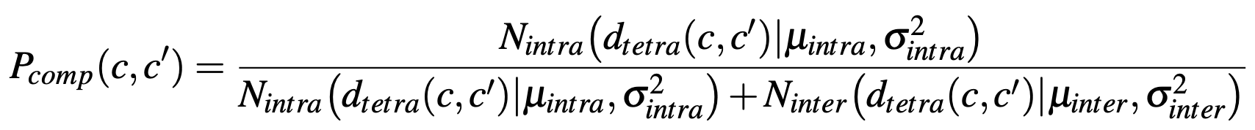
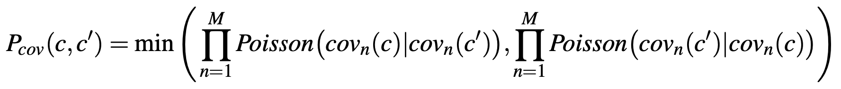
Adjust Clusters
Step 3b: Find a minimum-weight full matching using the weights of contigs to bins. The weights are:

Slide 16



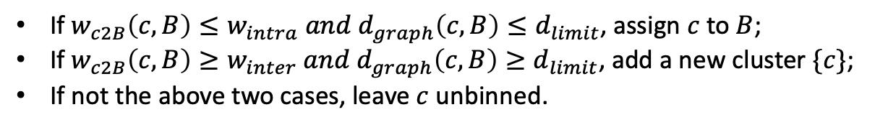
Adjust Clusters
Step 3c: According to the minimum-weight full matching, assign the contigs to the cluster:
If $w_{c2B}\left(c,B\right)≤w_{intra} and d_{graph}\left(c,B\right)≤d_{limit}$, assign $c$ to $B$;
If $w_{c2B}\left(c,B\right)≥w_{inter} and d_{graph}\left(c,B\right)≥d_{limit}$, add a new cluster $\{c\}$;
If not the above two cases, leave $c$ unbinned.
where
is defined as the average length of the shortest-path distances between contig c and all the contigs in bin B in the assembly graph.
are hyperparameters of thresholds for composition features.
is the hyperparameter of threshold for assembly graph.

Slide 17
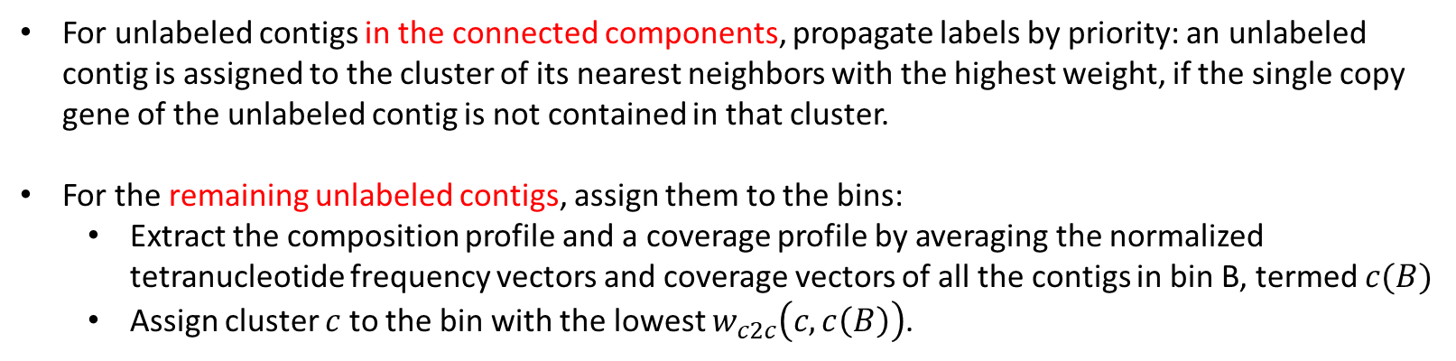
Label Propagation
For unlabeled contigs in the connected components, propagate labels by priority: an unlabeled contig is assigned to the cluster of its nearest neighbors with the highest weight, if the single copy gene of the unlabeled contig is not contained in that cluster.
For the remaining unlabeled contigs, assign them to the bins:
Extract the composition profile and a coverage profile by averaging the normalized tetranucleotide frequency vectors and coverage vectors of all the contigs in bin B, termed $c(B)$
Assign cluster $c$ to the bin with the lowest $w_{c2c}\left(c,c\left(B\right)\right)$.

Slide 18

Postprocessing: Merge clusters
Two bins $B_{1}$ and $B_{2}$ is mergeable, if $w_{c2c}\left(c\left(B_{1}\right),c\left(B_{2}\right)\right)≤w_{intra}.$
Construct a graph with bins as vertices, and an edge exists between $B_{1}$ and $B_{2}$ if they are mergeable.
Merge the maximal cliques in the constructed graph.

Slide 19
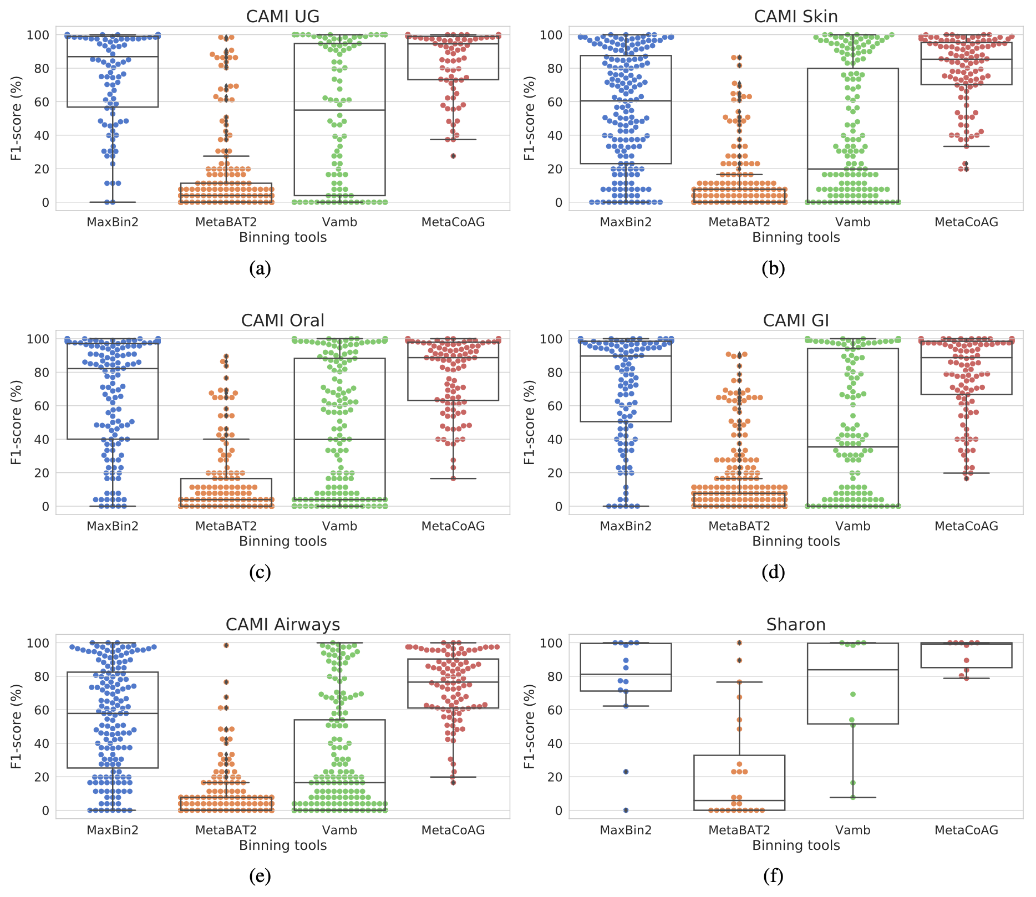
Results

